Slide 1

Demand
2.1
Copyright Bananaomics

Slide 2

If you just opened a business selling T shirts, what kind of information would you need to know?
Discuss with your partner
Copyright Bananaomics

Slide 3


Definitions
Market
  Where people who are willing and able to purchase a good, service or resource can carry out an exchange with those who are willing and able to provide that same good, service, or resource.
    Maybe a physical place, but most of the time in Economics, it's not.
      Factor Market
      Product Market
Demand
  The ABILITY and WILLINGNESS to purchase a quantity of a good or serviceat a certain price.
Copyright Bananaomics

Slide 4
Types of Demand
Individual
Individual demand is the demand of one person for a product.
Market
The market demand is the sum of all the individual demands for a product at every price.
Copyright Bananaomics

Slide 5

Law of Demand
An inverse relationship between price and quantity demanded.
As the price of a good rises, the quantity demanded will usually fall, ceteris paribus. (& vise versa)
Example: Higher price = Lower Quantity Demanded
Copyright Bananaomics

Slide 6

Video
THE LAW OF DEMAND
Copyright Bananaomics

Slide 7

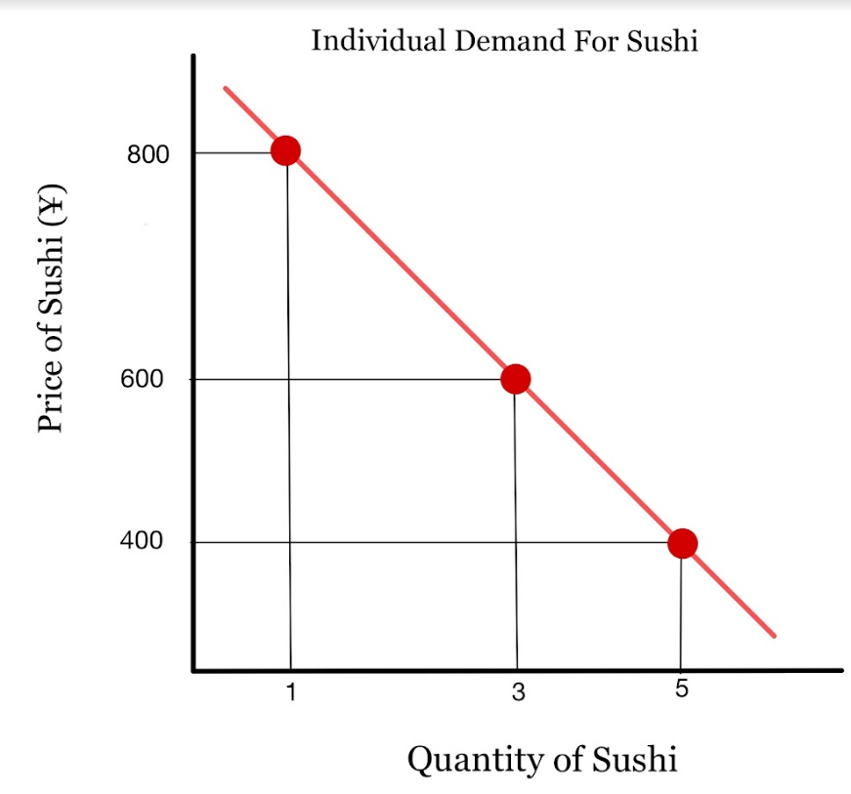
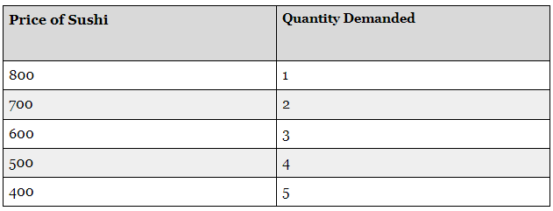
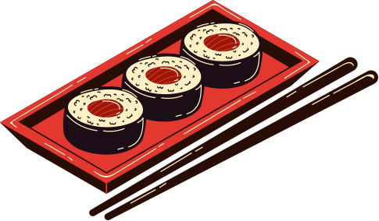
Demand Schedule
Individual
Copyright Bananaomics

Slide 8

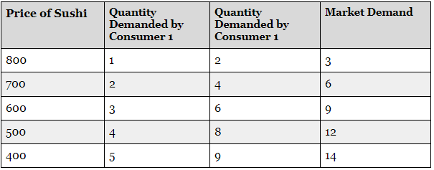

Demand Schedule
Market
Copyright Bananaomics

Slide 9

HL ONLY
Why?
The Law of Demand occurs for three main reasons.
  Income Effect
    As prices fall, "real income" (the amount their money is really worth) increases.
    If the price goes down for a product, the purchasing power increases for consumers -allowing them to purchase more.
    Example: If a pizza costs $2 and my income is $10, how many pizzas can I buy? What if the price of people drops by 50%?
  Substitution Effect
    As prices fall, the product becomes more attractive compared to other products whose prices remain unchanged. Therefore, consumers will purchase more of the cheaper product by substituting it for the more expensive product.
  Law of Diminishing Marginal Utility
    The principle is that as additional units of a good or services are consumed, the marginal utility will decline.
    In other words, the more you buy of ANY GOOD the less satisfaction you get from each new unit consumed.
    When you receive less satisfaction, you stop buying
Copyright Bananaomics

Slide 10
HL ONLY
Law of Diminishing Marginal Utility
The principle is that as additional units of a good or services are consumed, the marginal utility will decline.
The law of diminishing marginal utility states that as people consume additional units of a good or service, the marginal utility declines.
Consumers get less and less satisfaction from each additional unit.
REMEMBER: UTILITY = SATISFACTION
Copyright Bananaomics

Slide 11
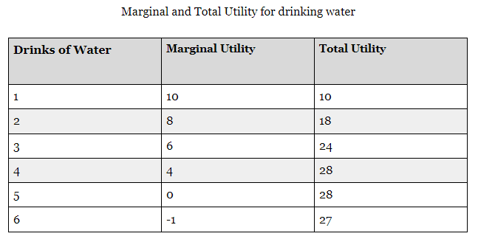
HL ONLY
Law of Diminishing Marginal Utility
Copyright Bananaomics

Slide 12
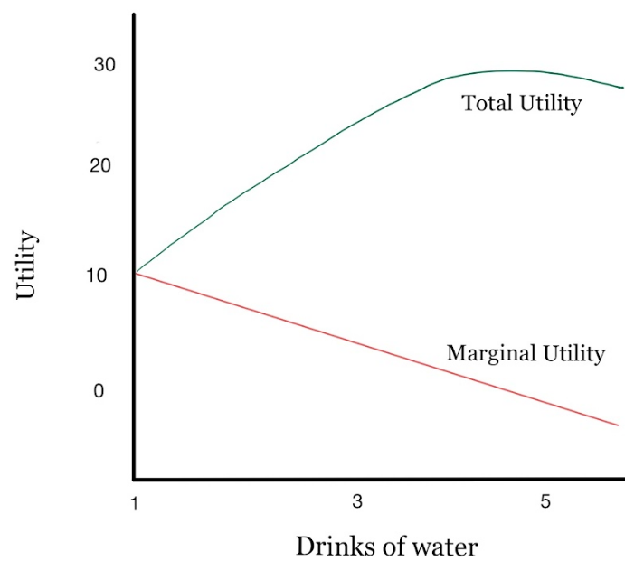
HL ONLY
Law of Diminishing Marginal Utility
Copyright Bananaomics

Slide 13
Movements and Shifts on the Demand Curve
Copyright Bananaomics

Slide 14




Changes to the Demand Curve
1. "Change in Quantity Demanded"
  Any change in price of a product simply moves ALONG the demand curve
2. "Change in Demand"
  The entire demand curve shifts.
  Something other than price has caused a change to the demand curve
    Technical Term: Non-Price Determinant of Demand
    Example: Change in Income
Copyright Bananaomics

Slide 15
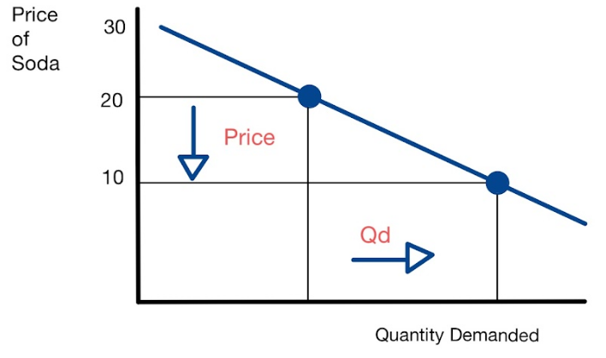
Change in Quantity Demanded
Change in Price of a Product
Copyright Bananaomics

Slide 16
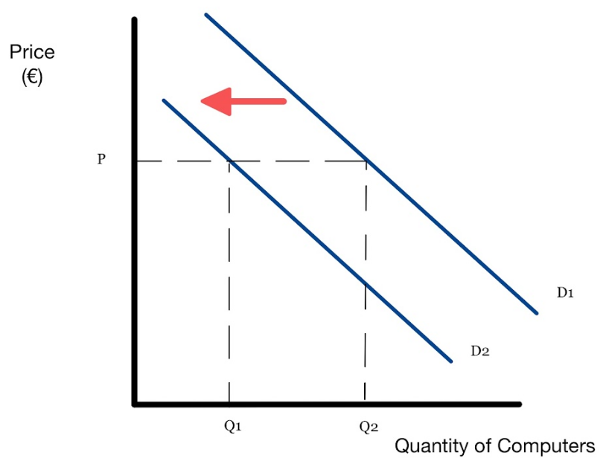
Change in Demand
Change in NON-PRICE determinant
Copyright Bananaomics

Slide 17

5 Demand Shifters
Copyright Bananaomics

Slide 18


5 Shifters of Demand
Income
Copyright Bananaomics

Slide 19

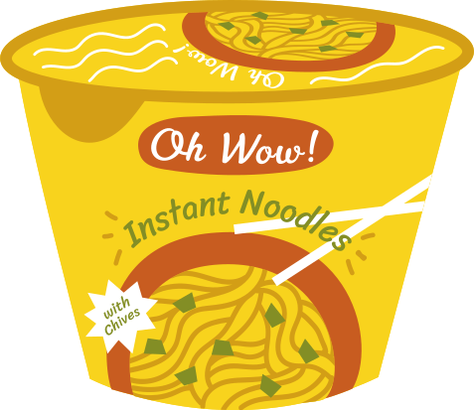
Income
The amount of income people have, and changes in their income, is an important factor influencing the demand for a good or service. The effect on the demand curve will depend on the type of good considered: normal goods and inferior goods.
Normal Goods
Inferior Goods
As income increases, Demand increases.
As income decreases, Demand increases. These tend to be lower quality, less expensive goods.
Copyright Bananaomics

Slide 20


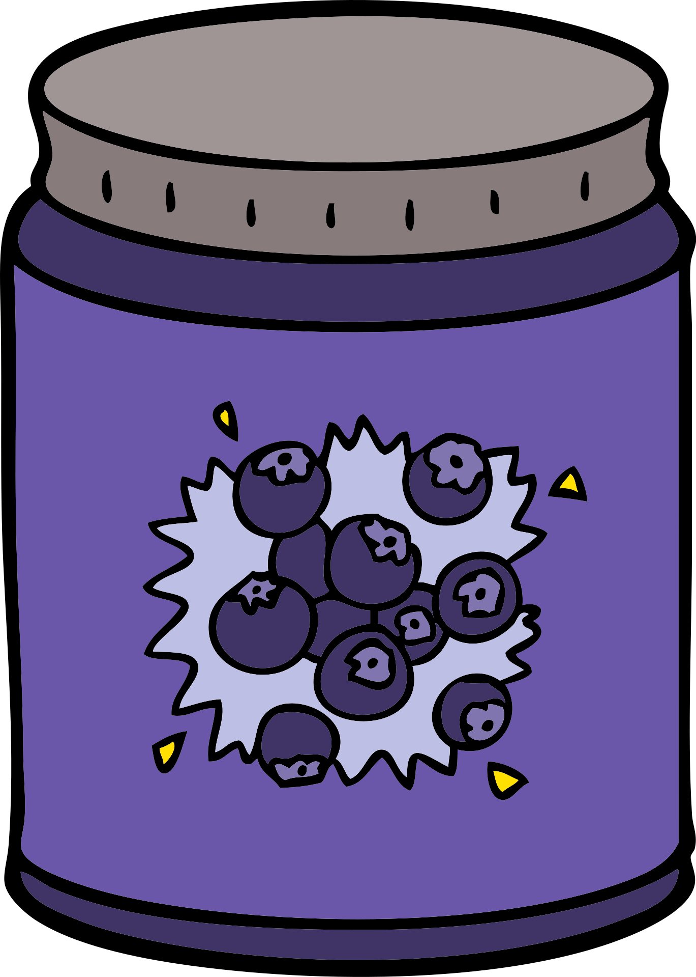
5 Shifters of Demand
Income
Price of Related Goods
Copyright Bananaomics

Slide 21







Related Goods
Goods can be substitutes for each other, complementary to each other or not related at all. When they are related in some way, a change in the price of one will result in a change in the demand of the other.
Complements
Substitutes
Two goods that are typically purchased or used together.
Two goods that are similar.
Copyright Bananaomics

Slide 22


5 Shifters of Demand
Income
Price of Related Goods
Tastes and Preferences
Copyright Bananaomics

Slide 23



Tastes and Preferences
When goods become more or less popular because of fashion, current events or promotion campaigns, demand is affected and the demand curve may shift to the right or to the left.
Copyright Bananaomics

Slide 24


5 Shifters of Demand
Income
Number of Consumers
Price of Related Goods
Tastes and Preferences
Copyright Bananaomics

Slide 25


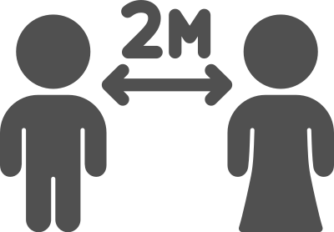
Number of Consumers
When goods become more or less popular because of fashion, current events or promotion campaigns, demand is affected and the demand curve may shift to the right or to the left.
Copyright Bananaomics

Slide 26

5 Shifters of Demand
Income
Number of Consumers
Price of Related Goods
Future Expectations
Tastes and Preferences
Copyright Bananaomics

Slide 27


Future Expectations
Expectations about the future can also affect the demand for goods and services.
Future Price
Future Economy
if people expect prices of goods and services to increase in the near future, they may decide to purchase more of the good now
If consumers expect the economy to do well, meaning consumers expect to keep their jobs and increase their incomes in the near future, they may increase their consumption of goods and services Vice Versa
Copyright Bananaomics

Slide 28

Practice
Copyright Bananaomics

Slide 29
Identify the determinant (shifter) then decide if demand will increase or decrease
Tacos (a normal good)
1.Population boom
2.Incomes fall due to recession
3.Price of hamburger, a substitute, decreases
4.Price increases to $5 for tacos
5.New health craze- “No ground beef”
6.Taco restaurants announce that they will significantly increase prices NEXT month
7.Price of salsa, a complement, increases
8.Restaurants lower price of tacos to $.50

Slide 30
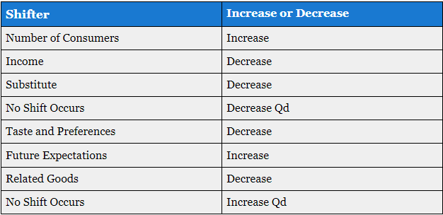
Results

Slide 31
Review
Copyright Bananaomics

Slide 32

Practice Question
Copyright Bananaomics

Slide 33
Paper 1 Part A
M14/3/ECONO/SP1/ENG/TZ2/XX
Copyright Bananaomics

Slide 34
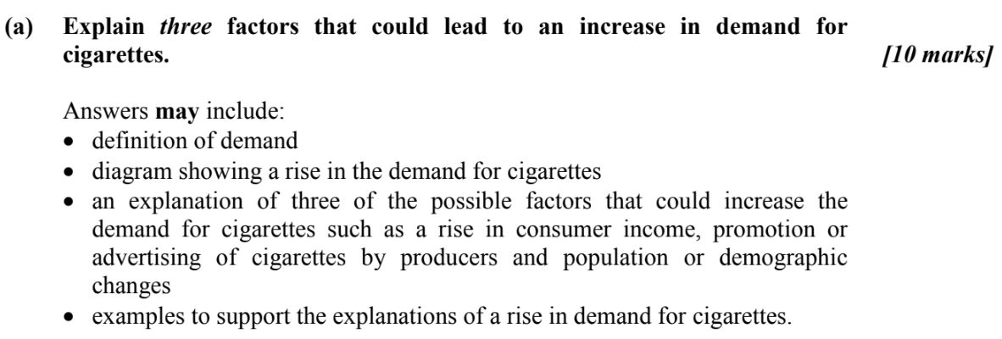
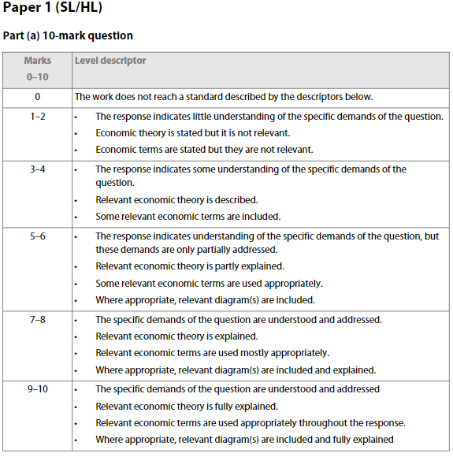
Check Answers
Copyright Bananaomics

Slide 35

Enjoying The Content?
Visit bananaomics.com to purchase package deals with discount prices!
BANANAOMICS

